Slide 1





Who are we?
Notes:
Talk about my experience at amazon 7 years, Madhavan is 3 years.
I started on a C++ team and switched to a Java team more on that later. Madhavan has been on my team since he has started.
Our team loves to play foosball and we practice TDD and Pair Programming on almost everything.
Give overview of presentation:
Our team,
Dependency isolation
TDD

Slide 2

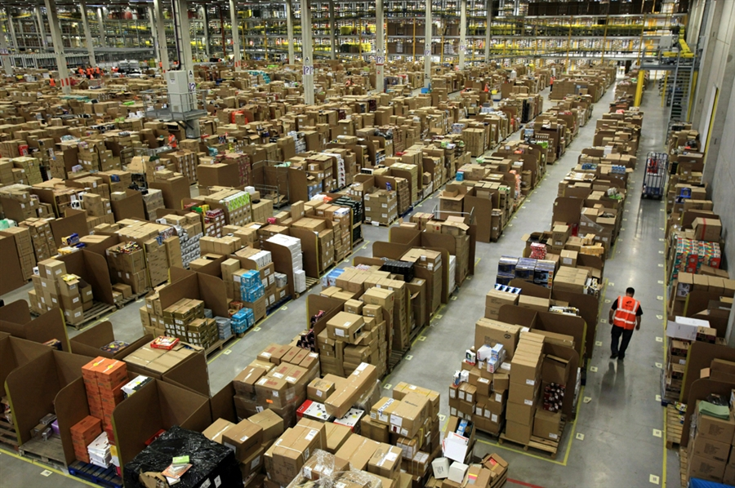
What do we do?
Fulfillment Optimization
Notes:
We take orders that you place on the website and decide which of our warehouses we are going to fulfill the orders from.
There are something like 40 warehouses in North America alone from which we can pick.

Slide 3
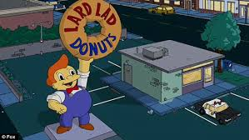


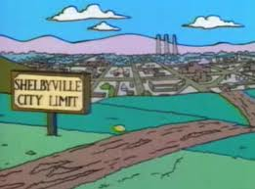
How do you decide?
$$
Supply
$
Assignment
Demand
Notes:
Here we see Homer wants a doughnut this is called the demand.
For supply we have:
A doughnut up here that costs two dollars
And a doughnut down here that costs one dollar.
The decision here is obvious, save a dollar and choose the doughnut down here. This is called the assignment.

Slide 4
Mmmm… doughnuts NOW!
6h
2h
$$
$
9h
Notes:
Now lets say Homer wants his doughnut in 6 hours.
The doughnut up here is going to take 2 hours, the doughnut down here is going to take 9 hours.
As a result we are going to have to use the more expensive supply and that assignment is going to cost us two dollars.

Slide 5
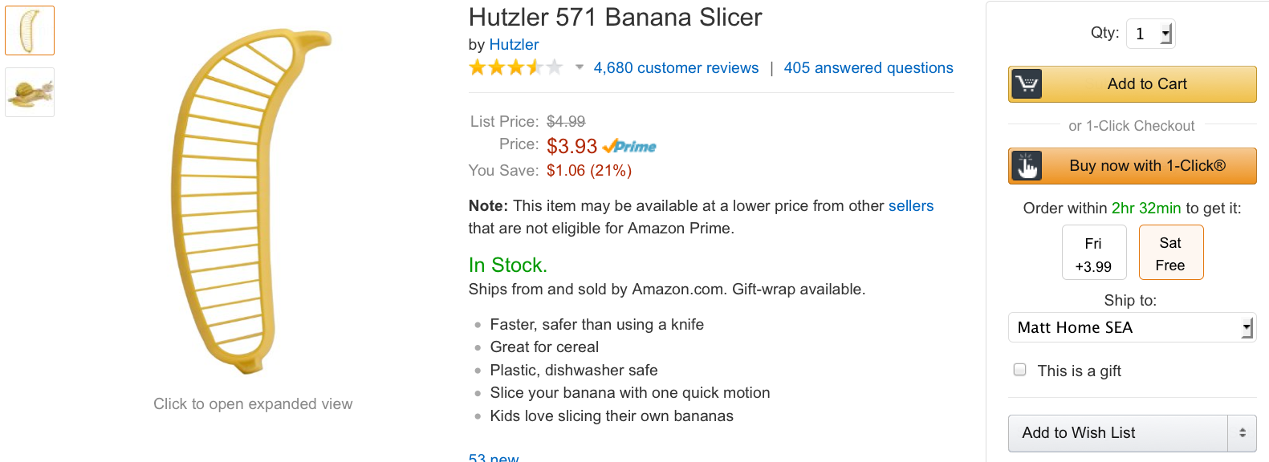
Make me a promise!
Notes:
Homer’s requirement to have the doughnut in 6 hours is what we call a Promised Delivery date or promise for short.
Customers on amazon.com can specify this requirement right here on the page.
Here, I am getting a promise for either Friday or Saturday delivery depending on how much I want to spend.
F2P calls this a constraint.

Slide 6

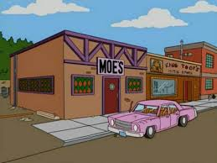
Thirsty? I’ll split it with ya
6h
2h
$$
$$$
2h
$
9h
Notes:
Lets add beer to make things interesting.
Now you see that we are going to have to split the assignment and ship the doughnut from here and the beer from here for a whopping 5 dollars.
The doughnut and beer here is not going to be able to make it to Homer in time.
Splits can cost us a lot of money so it’s important we understand them.

Slide 7
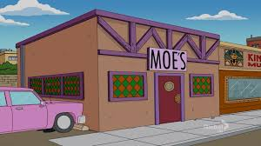

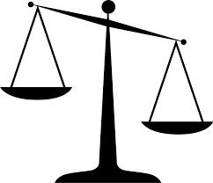

Additional factors considered
Notes:
Much of this information comes from other teams at Amazon.
This is because Amazon believes a lot in what is called service-oriented-architecture.

Slide 8
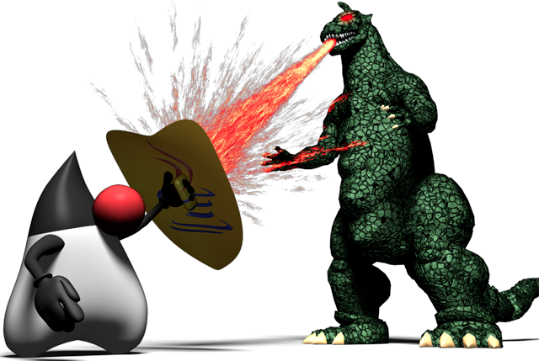
Java vs. C++
Notes:
So I want to go back and briefly talk about my experience at Amazon in a little more depth.
I started out on a C++ team that was also core the business, and there were a ton of struggles there. Eventually I got very frustrated and in a moment of weakness changed teams. My new team is not without it’s own problems but we are in a different league from my old team.
This the new team is all Java and did things very differently from my previous team.
Now, I will tell you that I am a Java-fan over C++ and I knew heading into this presentation that I would be taking on a community of people that believe in C++.
So I asked myself. “what was it about the new team that really made a difference irrespective of the language used?”
The core of the answer is that the new team believed in and practiced TDD. But what really set us apart is that we have figured out how to isolate ourselves from our dependent services.

Slide 9
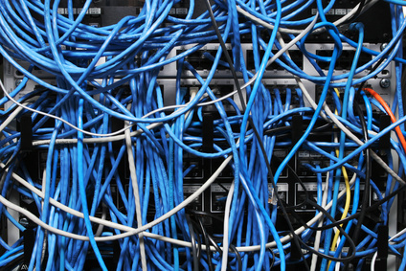
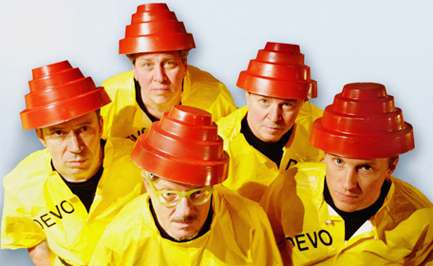
A major difficulty with SOA
Notes:
So lets go back and talked about SOA and some of the difficulties that come up with this approach to architecture.
Basic description of SOA:
Teams talk to each-other through http endpoints or message queues or whatever
Each team has a part of the system that is theirs. They get to specialize in that part of the problem and really dive deep into all the aspects of it.
If you can cleverly divide your space into services you can parallelize aspects of business requirements.
But one of the major drawbacks is that:
Important parts of your software are dependent on other peoples software.
We call these our dependent services.
So whenever I need to verify a new version of my software I need to ensure that all my dependencies are also working.
In order to do this teams at Amazon basically maintain two copies of their software. One call production which actually does stuff and one we call devo which is used for testing.

Slide 10

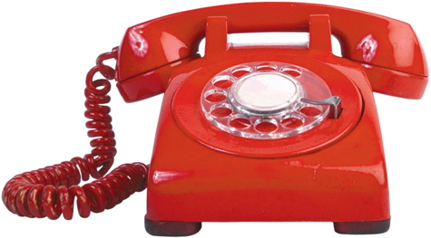
Problems with devo
Unstable
Old versions
Co-ordinated changes are hard
Slow
Hard to get support

Slide 11
What does SOA look like?
public class MyFulfillmentOptimizationService { private AmazonTransportCostService transportationCostService; public List<Shipment> pickBestShipments(Demand demand, Supply supply) { //... double cost = transportationCostService.calculateShipmentCost(shipment) //... } }
My Service
Their Service
Notes:
So lets actually have a look at what SOA really looks like in the microscope.

Slide 12
Put a layer in-between
public class MyFulfillmentOptimizationService { private TransportationCostGateway transportationCostGateway; public List<Shipment> pickBestShipments(Demand demand, Supply supply) { //... double cost = transportationCostGateway.calculateShipmentCost(shipment) //... } }
public class AmazonTransportationCostGateway implements TransportationCostGateway { private AmazonTransportCostService transportationCostService; public double calculateShipmentCost(Shipment shipment) { return transportationCostService.calculateShipmentCost(shipment); } }
public interface TransportationCostGateway { double calculateShipmentCost(Shipment shipment); }
My Service
Gateway
Their Service
Notes:
The big problem here is that we are dependent on other team’s services in order to test our service. If we could somehow break that dependency just for our testing purposes we could then test our software whether or not our dependencies were working at all.

Slide 13
Spy on them!
public class RecordingTransportationCostGateway implements TransportationCostGateway { private AmazonTransportCostService transportationCostService; private DataStorage storage; public double calculateShipmentCost(Shipment shipment) { double returnValue = transportationCostService.calculateShipmentCost(shipment); storage.store(shipment, returnValue); return returnValue; } }
MyService
Gateway
TheirService
Recorder
Storage
Notes:
The big problem here is that we are dependent on other team’s services in order to test our service. If we could somehow break that dependency just for our testing purposes we could then test our software whether or not our dependencies were working at all.

Slide 14
Eliminate them
public class ReplayTransportationCostGateway implements TransportationCostGateway { DataStorage storage; public double calculateShipmentCost(Shipment shipment) { return storage.get(shipment); } }
MyService
Gateway
TheirService
Recorder
Replay
Storage
Notes:
The big problem here is that we are dependent on other team’s services in order to test our service. If we could somehow break that dependency just for our testing purposes we could then test our software whether or not our dependencies were working at all.

Slide 15

Some extra tips
Try hard to use your types in the gateway. Not theirs.
Don’t think about just Services; think of any external dependencies you have. (like a Database).
Don’t get abstract! Until you have to
Notes:
Here are some extra tips that you can exercise when you are doing this.

Slide 16
TDD
?
Notes:
What does the second D in TDD stand for? Development or Design?
How many people here practice TDD in their daily job?
Do you have at least one automatic test?
Do ANY broken tests break the whole build?
Does anyone automatically deliver new features to production?

Slide 17

How I remember things before TDD…
Notes:
Tell a story from the SRW days.

Slide 18
Unit
Devo
System-Wide
Prod
Day
0%
Hours
1%
Minutes
4%
Msec-Second
95%
Notes:
Lots of unit tests the run quickly and will catch most problems.
A couple system-wide tests that can take minutes to run and will catch some higher-level problems.
A small number of very broad tests that perhaps include integration with other services. Hopefully catch very few problems.

Slide 19

How can I get more unit tests?

Slide 20
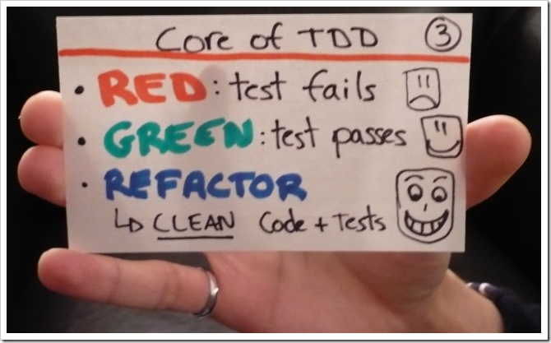
Write Failing Test
Refactor
Code to Pass Test
Notes:
Don’t write a bunch of tests, before writing a bunch of code.

Slide 21
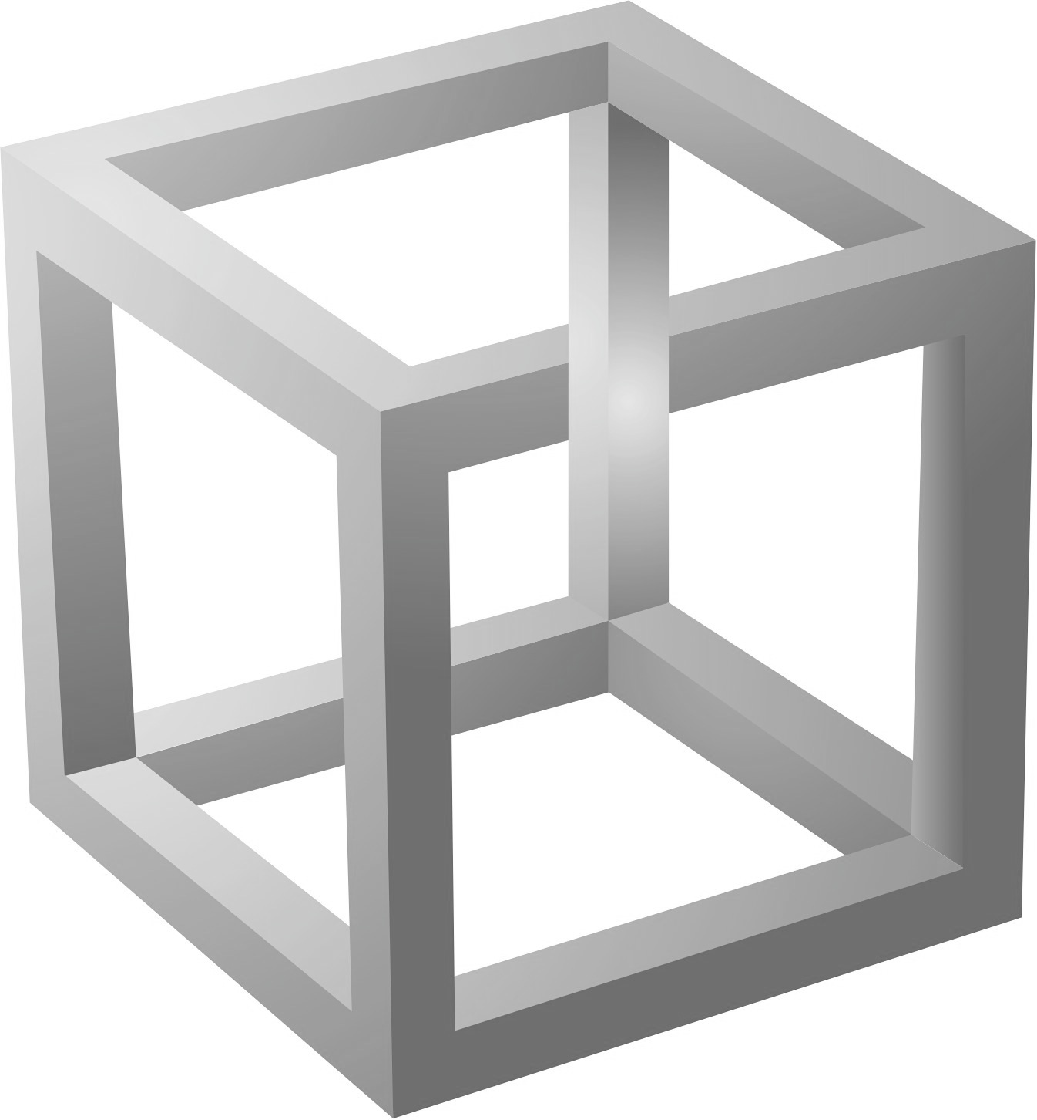
Common TDD Misconceptions
TDD is just writing tests
Writing the test first
Write TONS of tests before writing any code
Difficult tests represent difficult problems
Bad tests are worse than no tests

Slide 22

Okay, but why is TDD good?
# of Bugs
Failing tests
Documentation / Readability
Self-documenting
Modularity / Extensibility
Dependency Injection, Safety Net
Efficiency (ex. runtime)
Okay maybe TDD doesn’t do this (can it?)
Notes:
Pause, give time for people to think in their heads. Offer to take some suggestions from crowd.
How fast can you make a change?

Slide 23
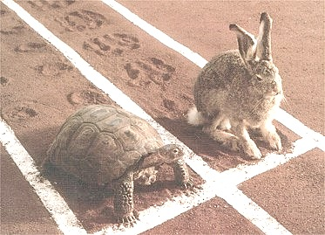
Additional Benefits of TDD
Feedback on “quality” of code
Focus
Debug units, not systems
Safety Net
Speed (controversial)
Shared Code Ownership

Slide 24
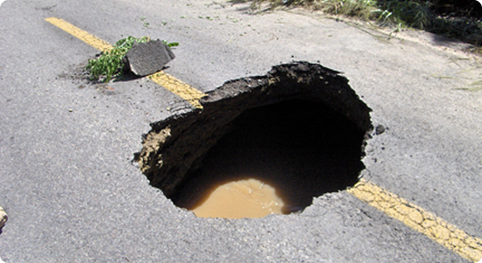
TDD pitfalls
I have a legacy system. I can’t write unit tests
Writing tests is hard to do
I don’t understand what tests to write
This is taking too long

Slide 25


If testing is hard…
Revisit the design

Slide 26


Slide 27
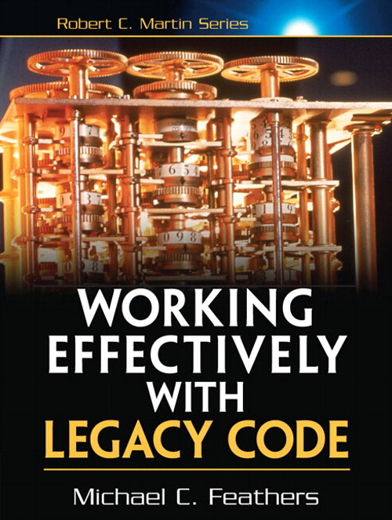

Slide 28
?

